Slide 1
Status Report
2015. 12. 9
Nam Jong Woo

Slide 2
Action Item
Background Estimation
Normalization Factor
Numbers
THStack

Slide 3
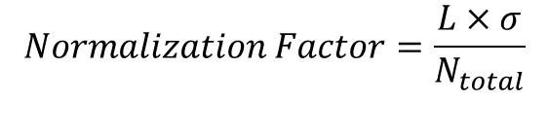
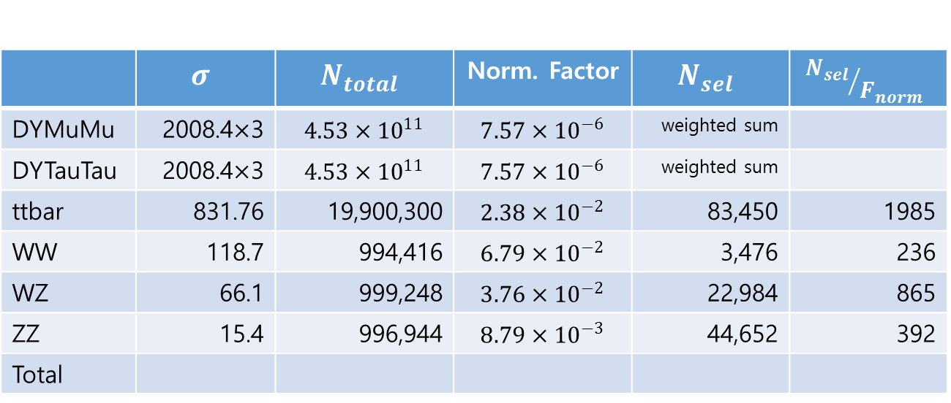
Normalization Factor
 | $$σ$$ | $$N_{total}$$ | Norm. Factor | $$N_{sel}$$ | $${N_{sel}}/{F_{norm}}$$
DYMuMu | 2008.4$×$3 | $$4.53×{10}^{11}$$ | $$7.57×{10}^{−6}$$ | weighted sum
DYTauTau | 2008.4$×$3 | $$4.53×{10}^{11}$$ | $$7.57×{10}^{−6}$$ | weighted sum
ttbar | 831.76 | 19,900,300 | $$2.38×{10}^{−2}$$ | 83,450 | 1985
WW | 118.7 | 994,416 | $$6.79×{10}^{−2}$$ | 3,476 | 236
WZ | 66.1 | 999,248 | $$3.76×{10}^{−2}$$ | 22,984 | 865
ZZ | 15.4 | 996,944 | $$8.79×{10}^{−3}$$ | 44,652 | 392
Total
$$Normalization Factor=\frac{L×σ}{N_{total}}$$

Slide 4
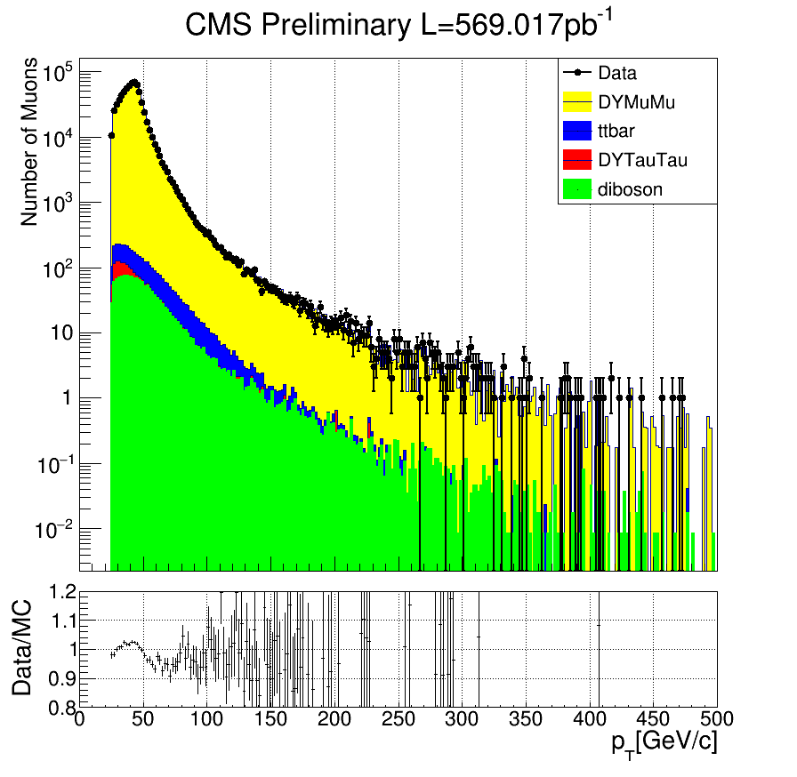

THStack $p_{T}$
DYMuMu
ttbar | 83,450
DYTauTau | 3,402
Diboson | 71,112

Slide 5
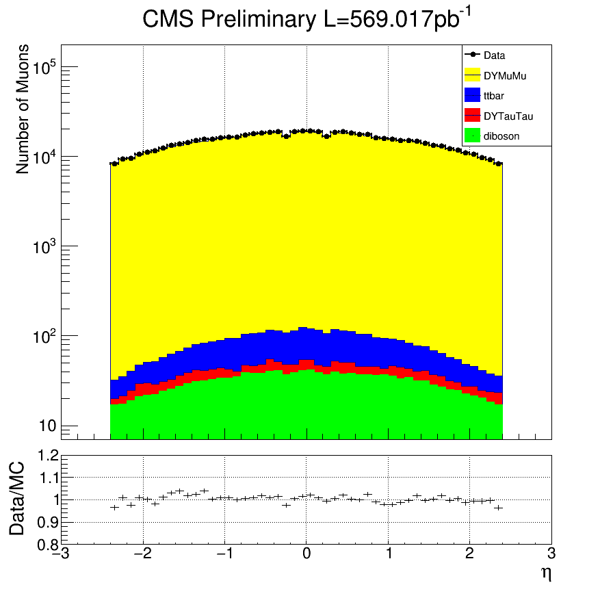

THStack $η$
DYMuMu
ttbar | 83,450
DYTauTau | 3,402
Diboson | 71,112

Slide 6
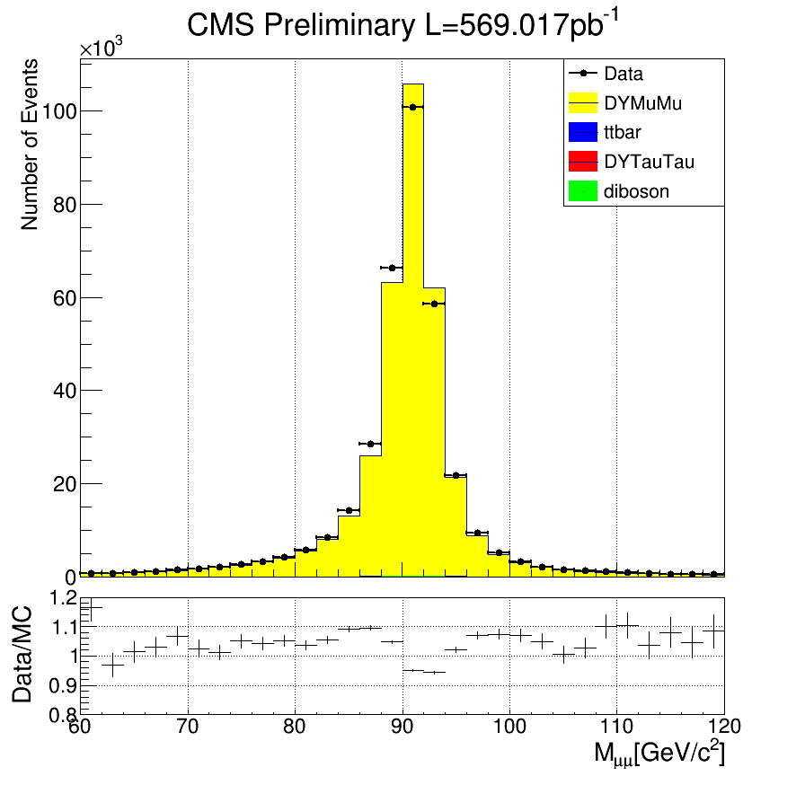
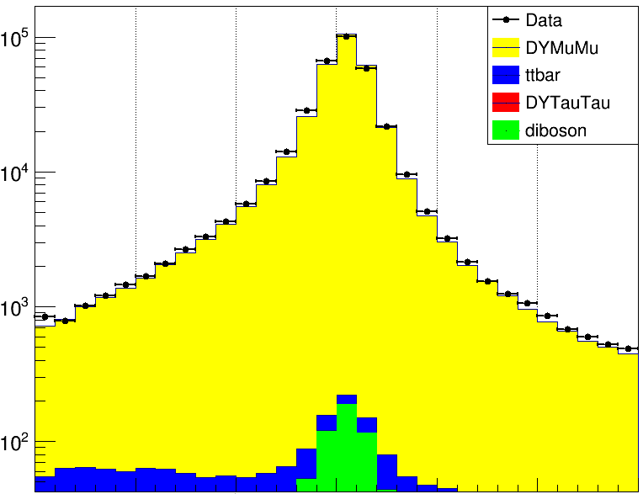
THStack $p_{T}$
DYMuMu
ttbar | 41,725
DYTauTau | 1,701
Diboson | 35,556

